Slide 1
Modifying Scales
RX 319
Introduction to Healthcare Analytics

Slide 2
Learning Objectives
Describe how to modify axis scales.
Contrast linear vs. log scale axes.
Distinguish when to use a linear or log scale axis.
2

Slide 3
A few ways to see your data clearer
Set axis limits different from the defaults
xlim(), ylim()
Example: ylim(100, 150) means y-axis will go from 100 to 150
Scale functions
scale_y_log10() to convert y-axis to log scale (similar for x-axis)
You can modify scales for any aesthetic (like a color scale)— optional
Chapter 28 (Graphics for Communication): https://r4ds.had.co.nz
Just add to your ggplot:
ggplot() +
geom_point(dat, aes(x=x, y=y)) +
scale_y_log10()
3

Slide 4
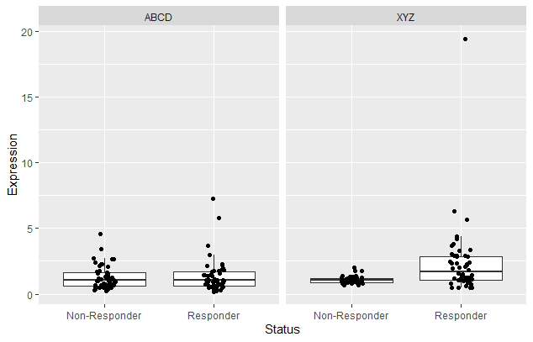
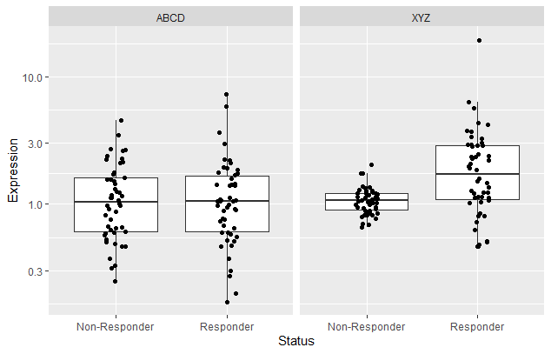
Log scales are nice sometimes
Gene expression data
Investigating whether a certain gene can predict whether someone will respond to treatment
Other data types
Acidity data (pH)
Concentration data
Earthquake measurements (Richter scale)
Data with a few very high values
scale_y_log10()
4

Slide 5
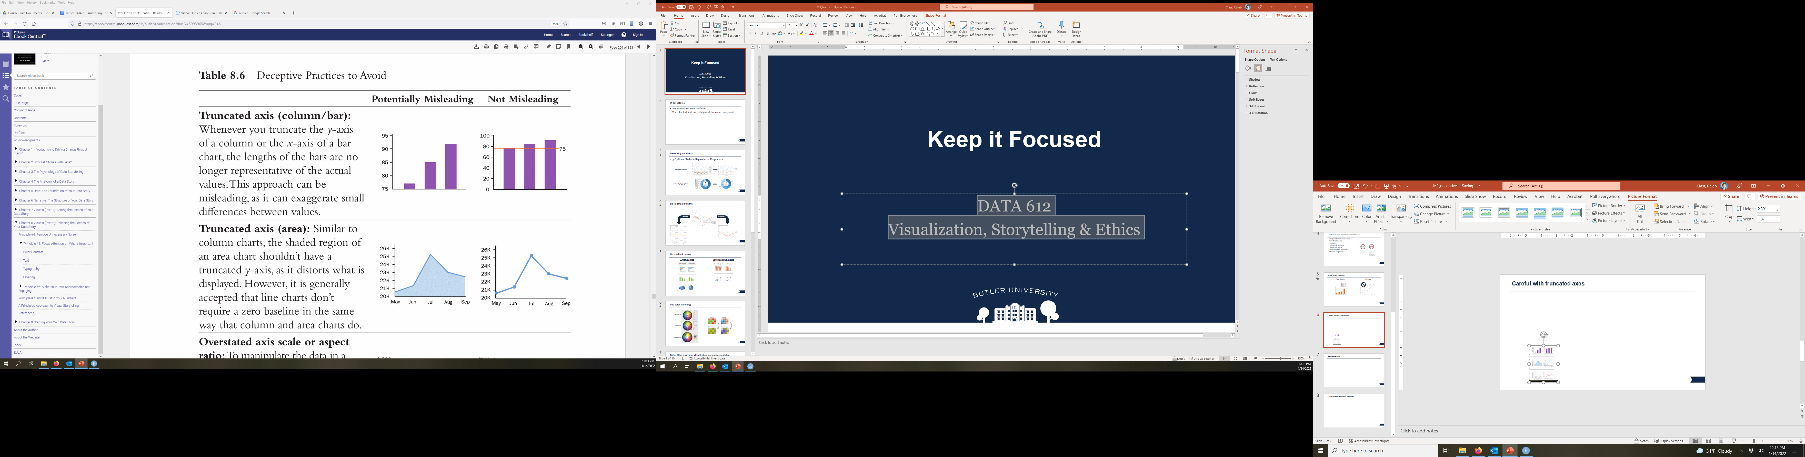
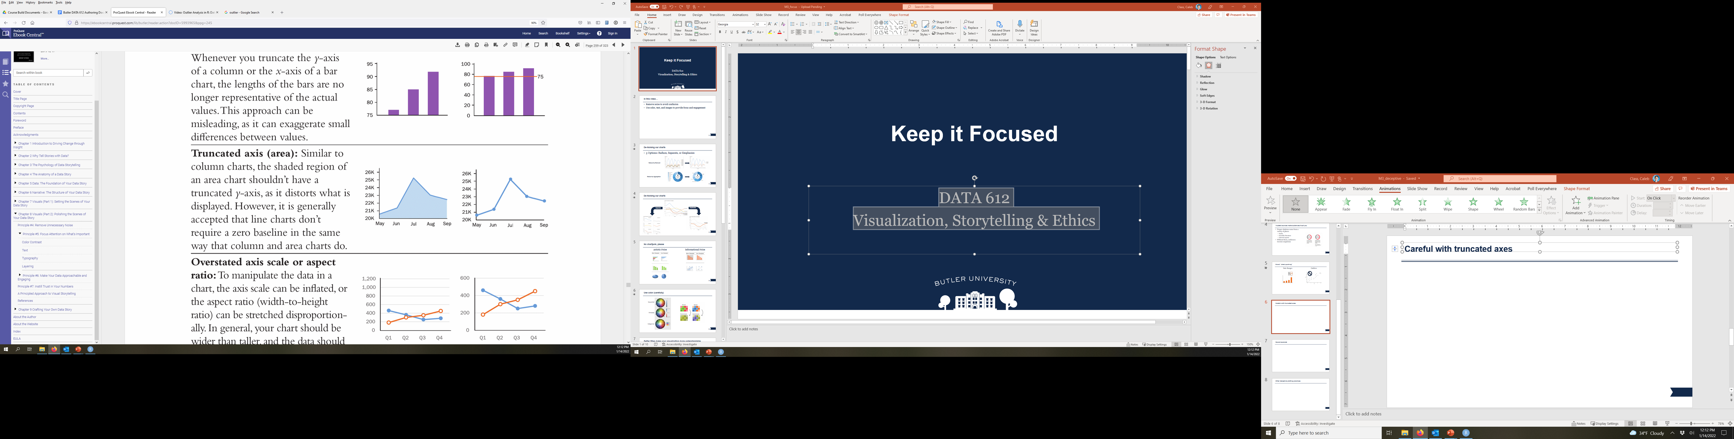
Be careful with your axes
5
Dykes, Brent (2020). Effective Data Storytelling: How to Drive Change with Data, Narrative, and Visuals. Hoboken, NJ, Wiley. E-Book available through Butler Libraries

Slide 6
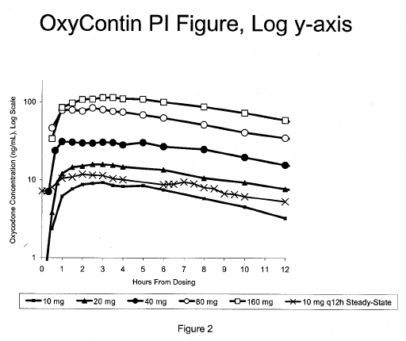
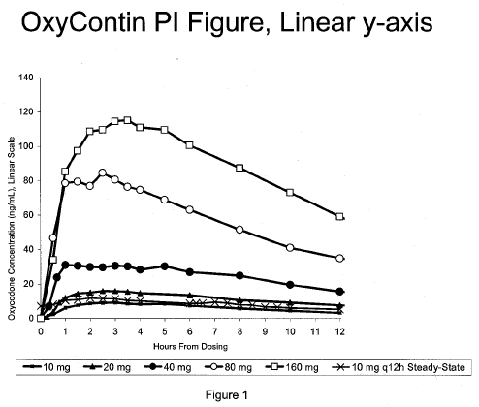
Be careful with log scales
OxyContin Concentration-Time Profile
(Log Scale)
OxyContin Concentration-Time Profile
(Linear Scale)
6
Edwards, Jim (2011). “How Purdue Used Misleading Charts to Hide OxyContin's Addictive Power”. CBS News.

